Slide 1
Topic
Lecture 01: Introduction to Fuzzy Sets

Slide 2
Concepts Covered:
Classical Set/Crisp Set
Properties of Classical Set/Crisp Set
Fuzzy Set
Representation of Fuzzy Set

Slide 3
Classical Set/Crisp Set (A)
Universal Set/Universe of Discourse (X): A set consisting of all possible elements
Ex: All technical universities in the world
Classical or Crisp Set is a set with fixed and well-defined boundary
Example: A set of technical universities having at least five departments each

Slide 4
Representation of Crisp Sets
A={a₁,a₂,……,a_{n}}
A={x|P(x)}, P: property
Using characteristic function
μ_{A}(x)=
1, if x belongs to A,
0, if x does not belong to A.

Slide 5
Notations Used in Set Theory
: Empty/Null set
: Element x of the Universal set X belongs to set A
: x does not belong to set A
: set A is a subset of set B
: set A is a superset of set B
: A and B are equal
: A and B are not equal

Slide 6
: A is a proper subset of B
: A is a proper superset of B
: Cardinality of set A is defined as the total number of
elements present in that set
p(A) : Power set of A is the maximum number of subsets
including the null that can be constructed from a set A
Note:

Slide 7
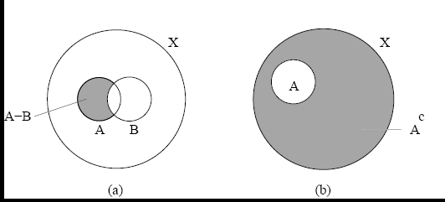

Crisp Set Operations
Difference: $A−B=\{x|x∈A and x∉B\}$
It is known as relative complement of set B with respect to set A
Absolute complement:
$$\overline{A}=A^{C}=X−A=\{x|x∈X and x∉A\}$$

Slide 8
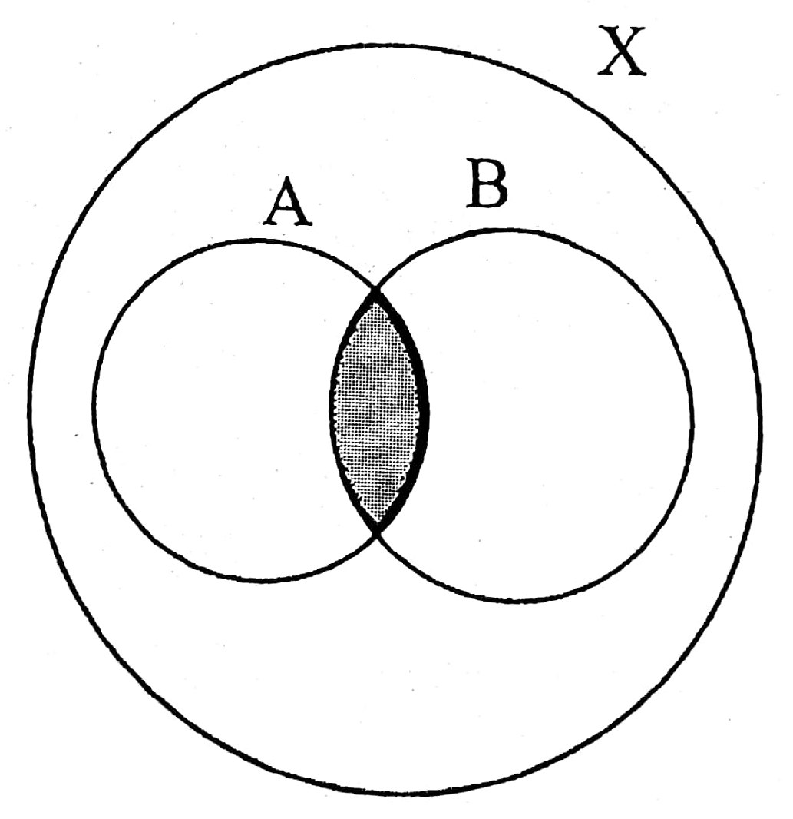

Intersection: $A∩B=\{x|x∈A and x∈B\}$

Slide 9
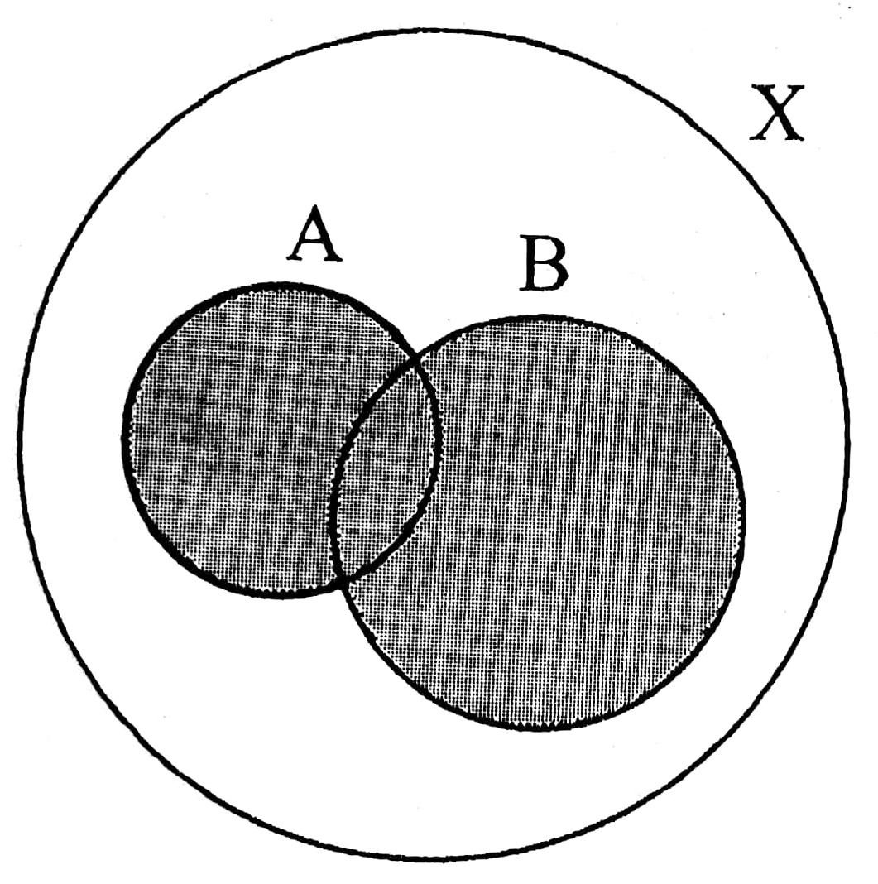

Union: $A∪B=\{x|x∈A or x∈B\}$

Slide 10
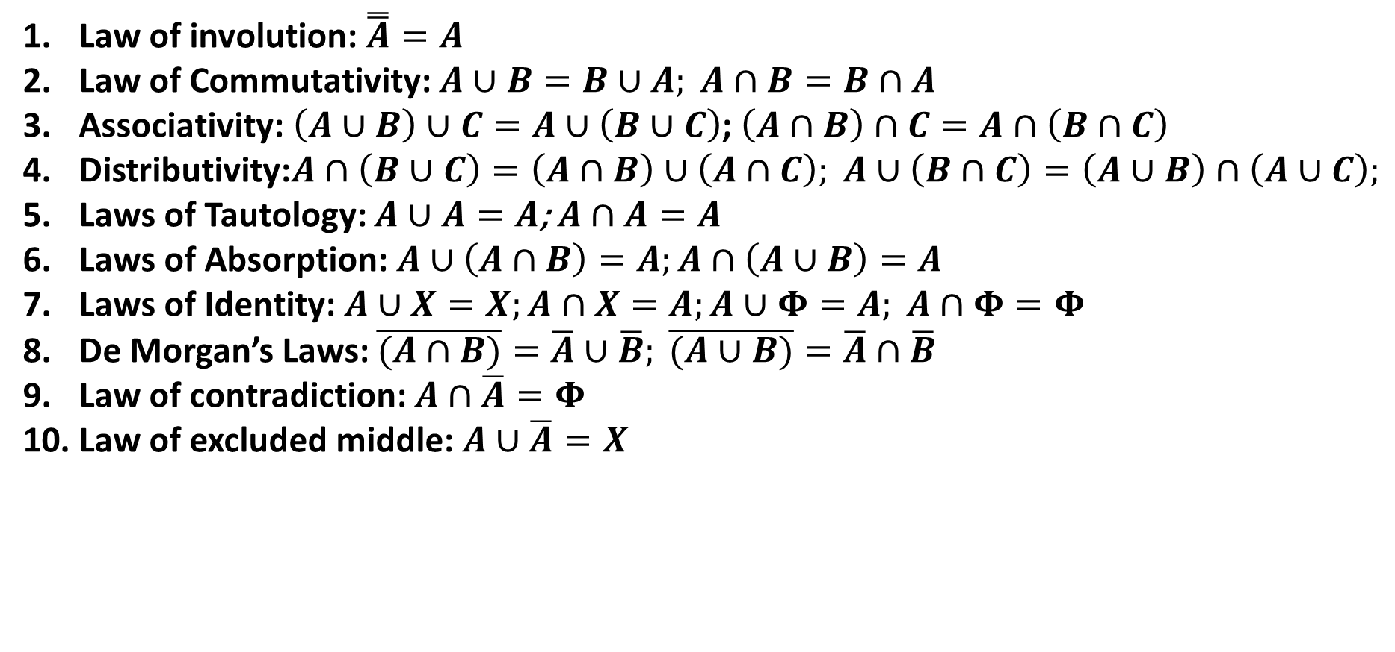
Properties of Crisp Sets
Law of involution: $\overset{̿}{A}=A$
Law of Commutativity: $A∪B=B∪A; A∩B=B∩A$
Associativity: $\left(A∪B\right)∪C=A∪\left(B∪C\right)$; $\left(A∩B\right)∩C=A∩\left(B∩C\right)$
Distributivity:$A∩\left(B∪C\right)=\left(A∩B\right)∪\left(A∩C\right); A∪\left(B∩C\right)=\left(A∪B\right)∩\left(A∪C\right);$
Laws of Tautology: $A∪A=A$; $A∩A=A$
Laws of Absorption:$A∪\left(A∩B\right)=A;A∩\left(A∪B\right)=A$
Laws of Identity: $A∪X=X;A∩X=A;A∪Φ=A; A∩Φ=Φ$
De Morgan’s Laws: $\overline{(A∩B)}=\overline{A}∪\overline{B}; \overline{(A∪B)}=\overline{A}∩\overline{B}$
Law of contradiction: $A∩\overline{A}=Φ$
Law of excluded middle: $A∪\overline{A}=X$

Slide 11
Fuzzy Sets
Sets with imprecise/vague boundaries
Introduced by Prof. L.A. Zadeh, University of California, USA, in 1965
Potential tool for handling imprecision and uncertainties
Fuzzy set is a more general concept of the classical set

Slide 12
Representation of a Fuzzy Set
Note:
Probability: Frequency of likelihood that an element is in a class
Membership: Similarity of an element to a class

Slide 13
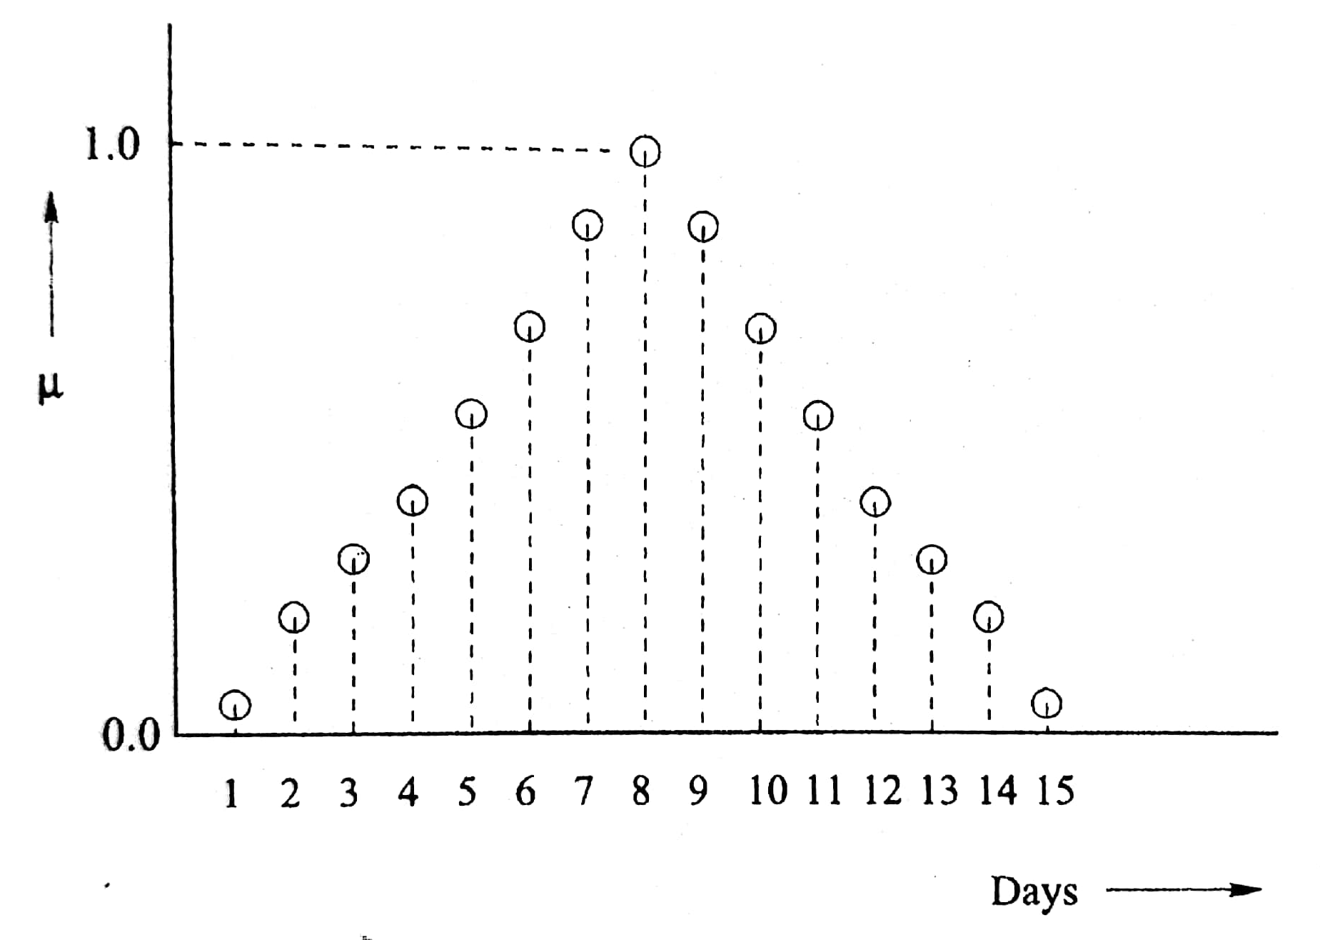
Types of Fuzzy sets
1. Discrete Fuzzy set
n: Number of elements present in the set
2. Continuous Fuzzy set

Slide 14
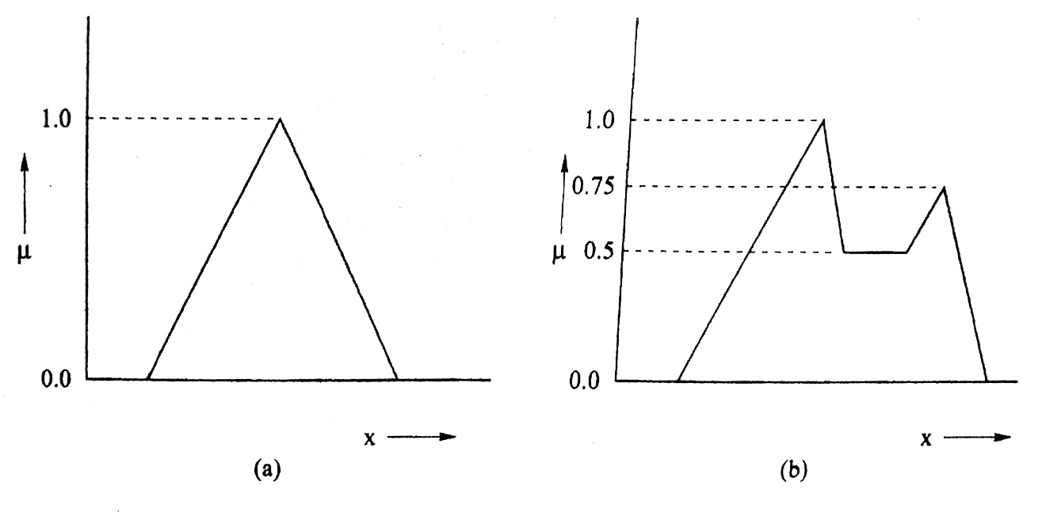
Convex vs. Non-Convex Membership Function Distribution
A fuzzy set A(x) will be convex, if
Where 0.0 ≤ λ ≤ 1.0

Slide 15
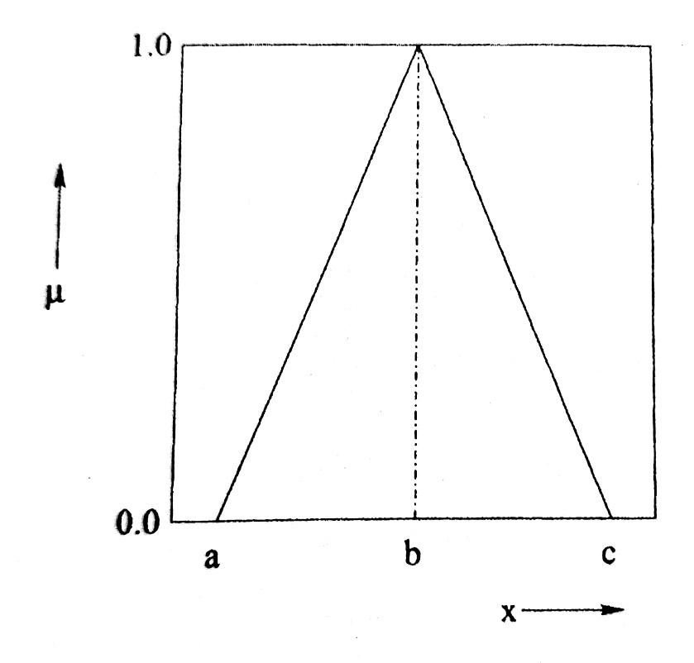
Various Types of Membership Function Distributions
1. Triangular Membership

Slide 16
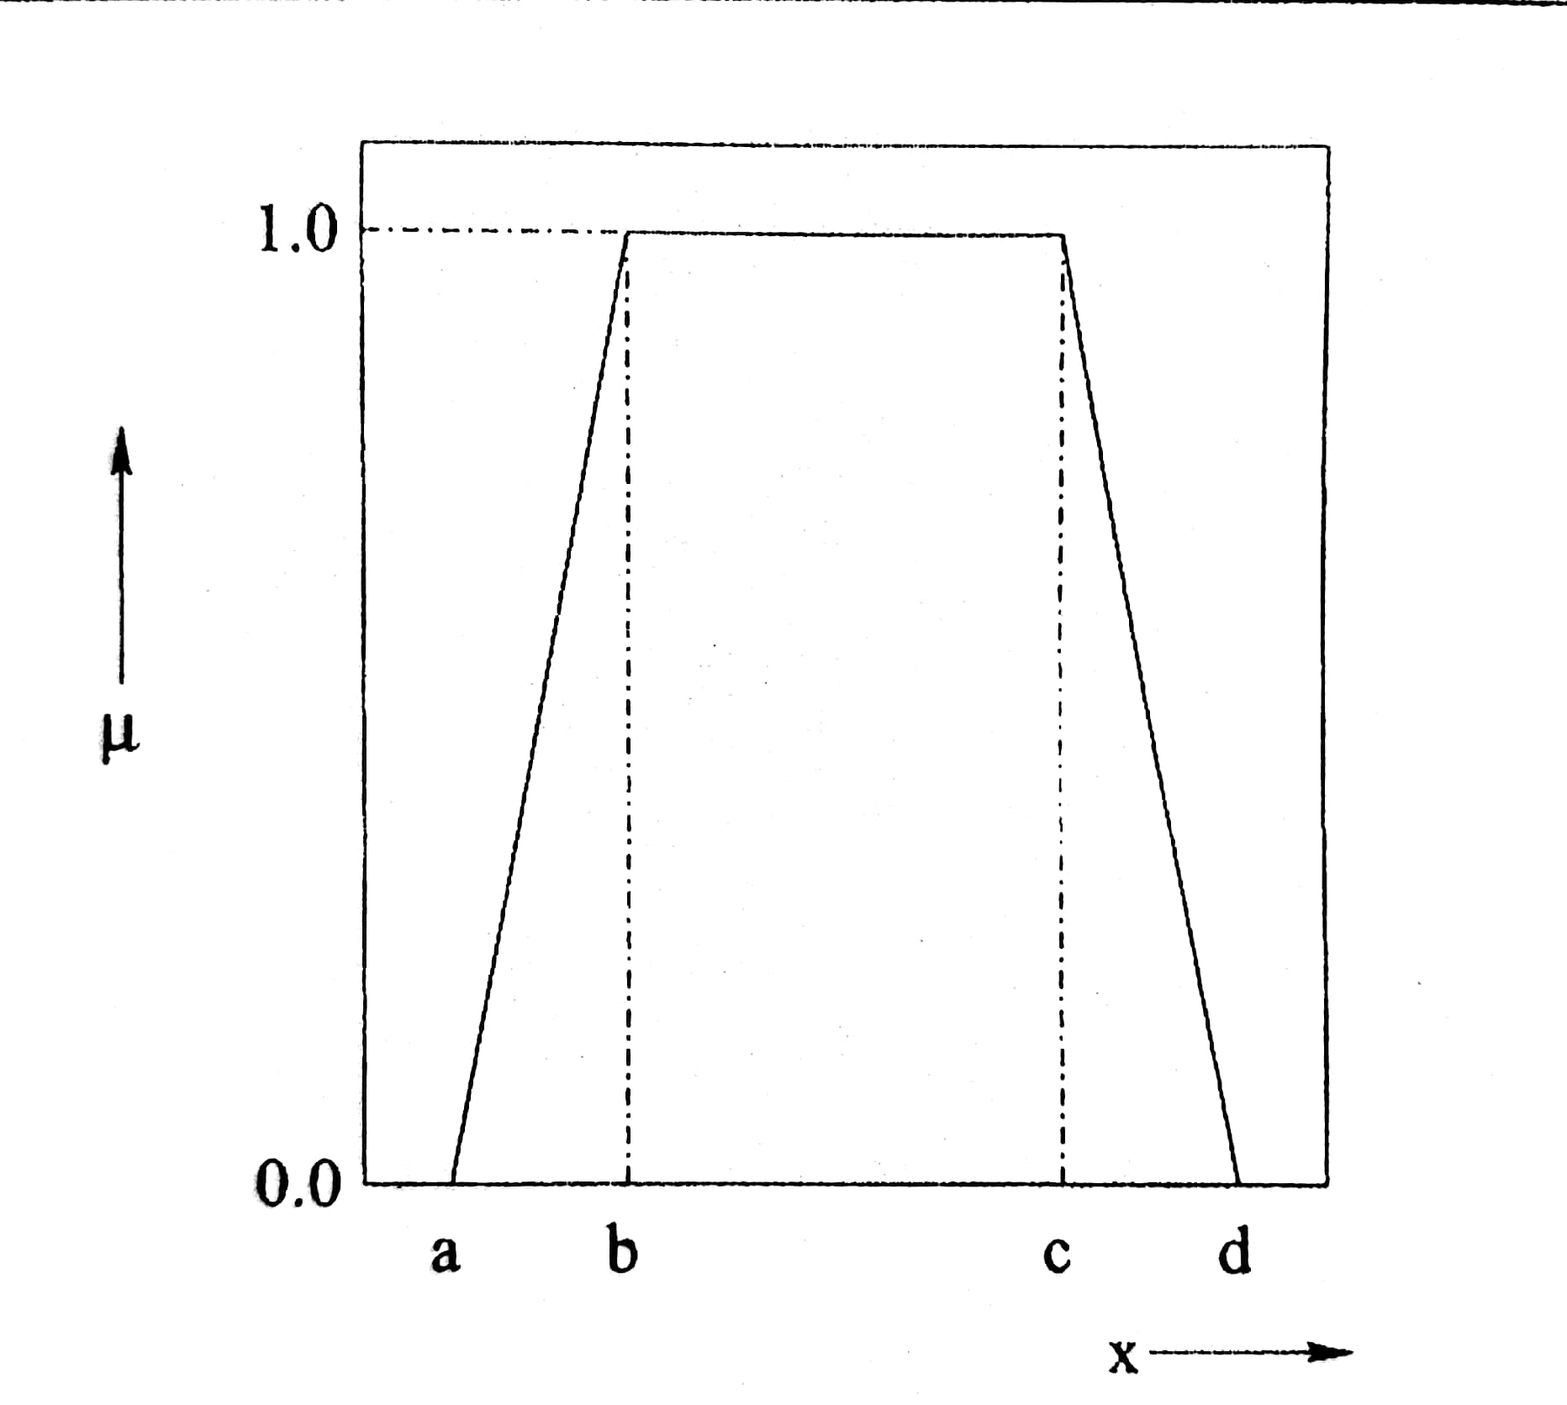
2. Trapezoidal Membership

Slide 17
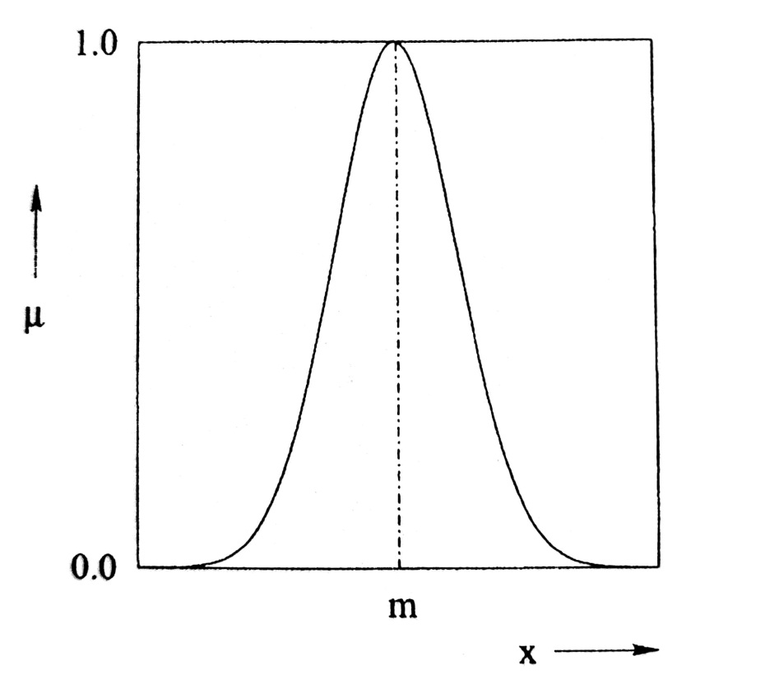
3. Gaussian Membership

Slide 18
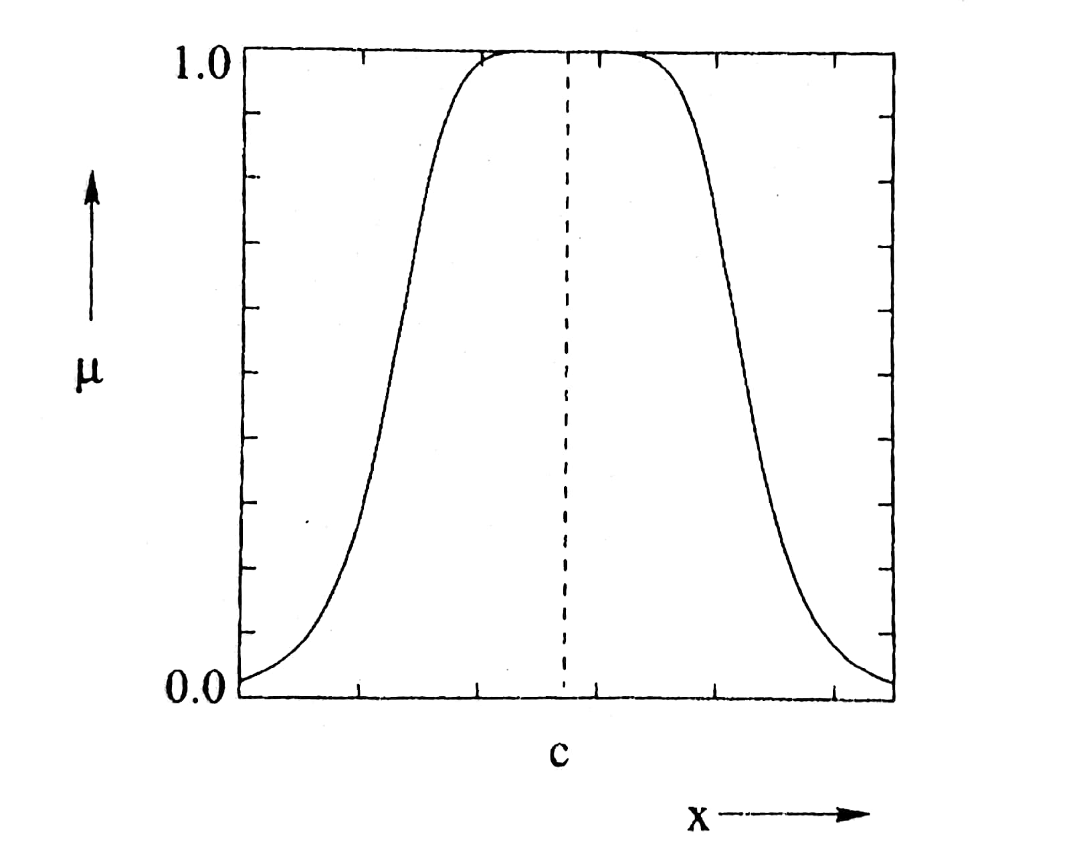
4. Bell-shaped Membership Function

Slide 19
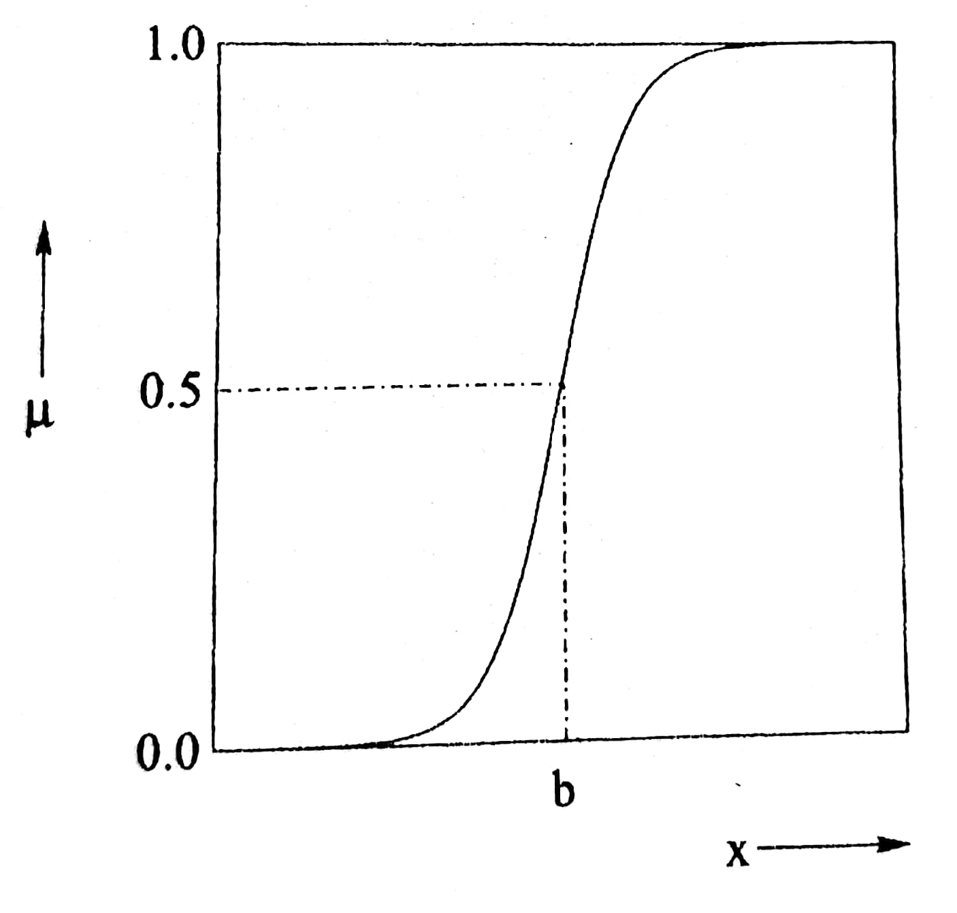
5. Sigmoid Membership

Slide 20
Summary:
Classical Set/Crisp Set has been defined
Properties of Classical Set/Crisp Set has been explained
Fuzzy Set has been defined
Deals with representation of Fuzzy Set

Slide 21
Concepts Covered:
A few terms of Fuzzy Sets
Standard Operations in Fuzzy Sets
Properties of Fuzzy Sets

Slide 22
Numerical Example
Triangular Membership: Determine μ, corresponding to x=8.0
1.0
μ
0.0
8
a=2
b=6
c=10
x

Slide 23


$$μ_{triangle}=max[min\left(\frac{x−a}{b−a},\frac{c−x}{c−b}\right),0]$$
$=max[min\left(\frac{x−2}{6−2},\frac{10−x}{10−6}\right),0]$
$=max[min\left(\frac{x−2}{4},\frac{10−x}{4}\right),0]$
We put, x=8.0
$$μ_{triangle}=max\left[min\left(\frac{3}{2},\frac{1}{2}\right),0\right]= \frac{1}{2}=0.5$$

Slide 24
Trapezoidal Membership
Determine μ corresponding to x = 3.5

Slide 25

$$μ_{trapezoidal}$$

Slide 26

We put x = 3.5
$$μ_{trapezoidal}$$

Slide 27
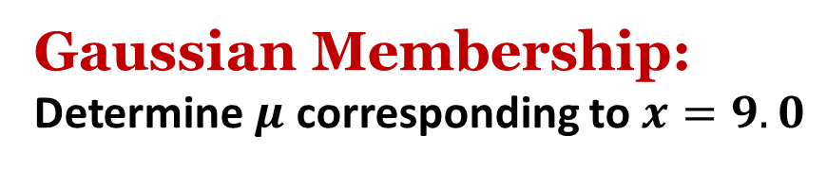



Gaussian Membership:
Determine $μ$ corresponding to $x=9.0$
1.0
$$μ$$
0.0
$$m$$
$$x$$

Slide 28
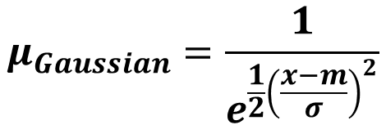
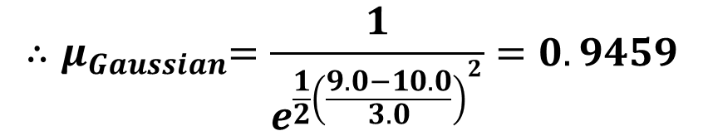

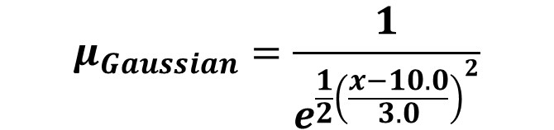
$$μ_{Gaussian}=\frac{1}{e^{\frac{1}{2}{\left(\frac{x−m}{σ}\right)}^{2}}}$$
$$Take m=10.0 and σ=3.0$$
$$μ_{Gaussian}=\frac{1}{e^{\frac{1}{2}{\left(\frac{x−10.0}{3.0}\right)}^{2}}}$$
We put $x=9.0$
$${∴μ}_{Gaussian}=\frac{1}{e^{\frac{1}{2}{\left(\frac{9.0−10.0}{3.0}\right)}^{2}}}=0.9459$$

Slide 29

Bell-shaped Membership function: Determine μ corresponding to $x=8.0$
1.0
μ
0.0
c
x

Slide 30

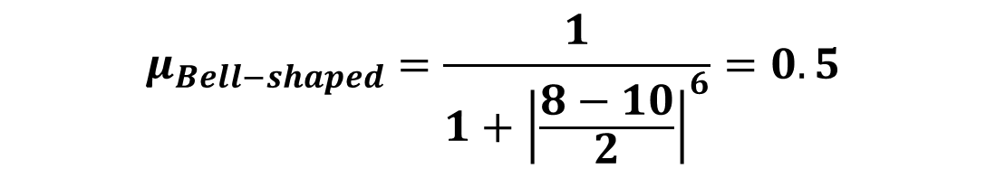

$$μ_{Bell−shaped}=\frac{1}{1+{\left|\frac{x−c}{a}\right|}^{2b}}$$
Take c=10.0, a=2.0, b=3.0
$$μ_{Bell−shaped}=\frac{1}{1+{\left|\frac{x−10}{2}\right|}^{6}}$$
We put x=8.0
$$μ_{Bell−shaped}=\frac{1}{1+{\left|\frac{8−10}{2}\right|}^{6}}=0.5$$

Slide 31
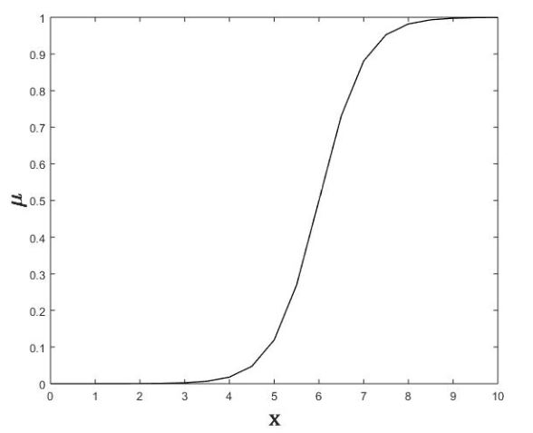
Sigmoid Membership Function:
Determine µ corresponding to x = 8.0

Slide 32
Difference Between Crisp and Fuzzy Sets

Slide 33
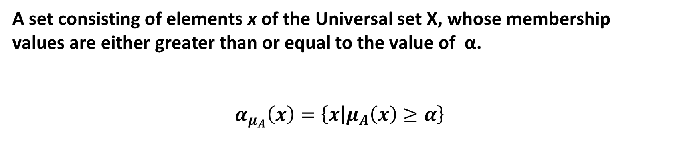
A Few Definitions in Fuzzy Sets
α-cut of a fuzzy set $α_{μ_{A}}\left(x\right)$
A set consisting of elements x of the Universal set X, whose membership values are either greater than or equal to the value of α.
$$α_{μ_{A}}\left(x\right)=\left\{x | μ_{A}\left(x\right)≥α\right\}$$

Slide 34
Strong α-cut of a Fuzzy Set
$$α_{μ_{A}}^{+}\left(x\right)=\left\{x | μ_{A}(x)>α\right\}$$

Slide 35
Numerical Example
The membership function distribution of a fuzzy set is assumed to follow a Gaussian distribution with mean m = 100 and standard deviation σ =20 . Determine 0.6 – cut of this distribution.
Solution:
Gaussian distribution :
where m : Mean ; σ : Standard deviation
By substituting the values of µ = 0.6, m = 100, σ =20 and
taking log (ln) on both sides, we get

Slide 36
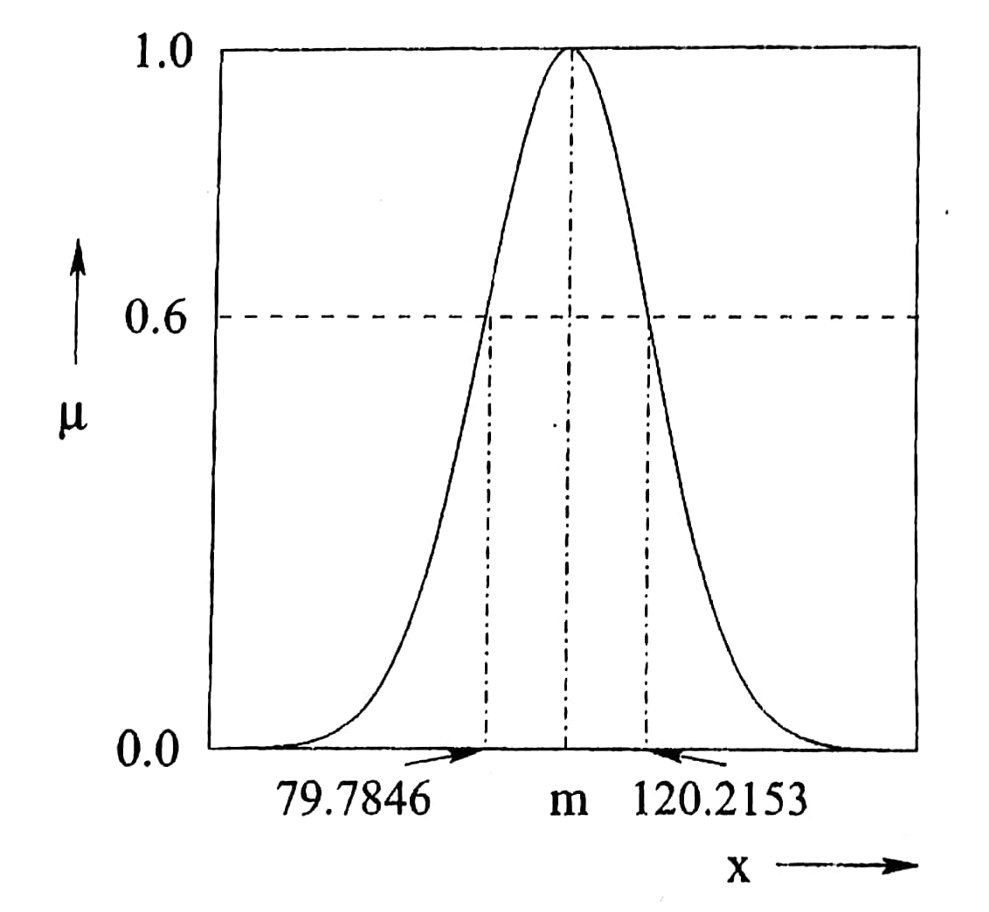
Figure : 0.6-cut of a fuzzy set.

Slide 37
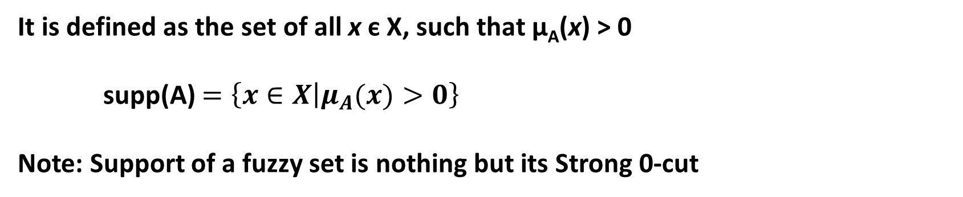

Support of a Fuzzy Set A(x)
It is defined as the set of all x є X, such that μ_{A}(x) > 0
supp(A) $=\left\{x∈X | μ_{A}(x)>0\right\}$‏
Note: Support of a fuzzy set is nothing but its Strong 0-cut
Scalar Cardinality of a Fuzzy Set A(x)
$$\left|A(x)\right|=\sum_{x∈X}{μ_{A}(x)}$$

Slide 38
Numerical Example

Slide 39
Core of a Fuzzy Set A(x)
It is nothing but its 1-cut
Height of a Fuzzy Set A(x)
It is defined as the largest of membership values of the elements
contained in that set.

Slide 40
Normal Fuzzy Set
For a normal fuzzy set, h(A) = 1.0
Sub-normal Fuzzy Set
For a sub-normal fuzzy set, h(A) < 1.0

Slide 41
Some Standard Operations in Fuzzy Sets
Proper Subset of a Fuzzy Set
$$A\left(x\right)⊂B\left(x\right), if μ_{A}\left(x\right)<μ_{B}(x)$$

Slide 42
Numerical Example

Slide 43
Some Standard Operations in Fuzzy Sets (contd.)
Equal fuzzy sets
$$A\left(x\right)=B\left(x\right), if μ_{A}\left(x\right)=μ_{B}(x)$$

Slide 44
Numerical Example

Slide 45
Complement of a Fuzzy Set
$$\overline{A}\left(x\right)=1−A(x)$$

Slide 46
Numerical Example

Slide 47

Intersection of Fuzzy Sets
Intersection of two fuzzy sets A(x) and B(x) is denoted by $(A∩B)(x)$
and its membership values are determined as follows :
$$μ_{(A∩B)} \left(x\right)=min\{μ_{A} \left(x\right),μ_{B} \left(x\right)\}$$

Slide 48
x
Note: Intersection is analogous to logical AND operation

Slide 49
Numerical Example

Slide 50
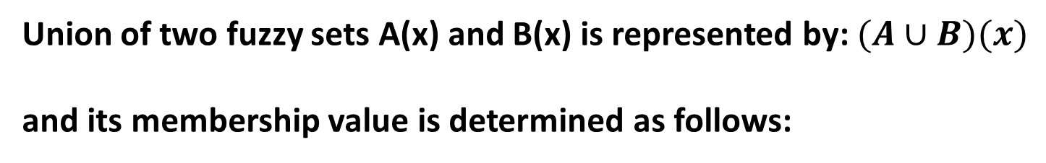
Union of Fuzzy Sets
Union of two fuzzy sets A(x) and B(x) is represented by: $(A∪B)(x)$
and its membership value is determined as follows:
$$μ_{(A∪B)} \left(x\right)=max\{μ_{A} \left(x\right),μ_{B} \left(x\right)\}$$

Slide 51
Note: Union is analogous to logical OR operation

Slide 52
Numerical Example

Slide 53
Algebraic product of Fuzzy Sets
$$A \left(x\right).B(x)=\{\left(x,μ_{A} \left(x\right).μ_{B} \left(x\right)\right),x∈X\}$$

Slide 54
Numerical Example

Slide 55
Multiplication of a Fuzzy Set by a Crisp Number
$$d.A \left(x\right)=\{\left(x,{d×μ}_{A} \left(x\right)\right),x∈X\}$$

Slide 56
Numerical Example

Slide 57
Power of a Fuzzy Set
A^{P}(x): p-th power of a fuzzy set A(x) such that
Concentration: p=2
Dilation: p=1/2
$$μ_{A^{p}}\left(x\right)={\{μ_{A}\left(x\right)\}}^{p},x∈X$$

Slide 58
Numerical Example

Slide 59
Algebraic Sum of two Fuzzy Sets A(x) and B(x)
$$A\left(x\right)+B(x)=\{(x,μ_{A+B}\left(x\right)),x∈X\}$$
where
$$μ_{A+B}\left(x\right)=μ_{A}\left(x\right)+μ_{B}\left(x\right)−μ_{A}\left(x\right).μ_{B}\left(x\right)$$

Slide 60
Numerical Example

Slide 61
Bounded Sum of two Fuzzy Sets
$$A\left(x\right)⨁B(x)=\{(x,μ_{A⨁B}\left(x\right)),x∈X\}$$
where
$$μ_{A⨁B}\left(x\right)={min\{1,μ}_{A}\left(x\right)+μ_{B}\left(x\right)\}$$

Slide 62
Numerical Example

Slide 63
Algebraic Difference of two Fuzzy Sets
$$A\left(x\right)−B(x)=\{(x,μ_{A−B}\left(x\right)),x∈X\}$$
where
$$μ_{A−B}\left(x\right)=μ_{A∩\overline{B}}(x)$$

Slide 64
Numerical Example
Let us consider the following two fuzzy sets:

Slide 65
Bounded Difference of two Fuzzy Sets
$$A\left(x\right)ΘB(x)=\{(x,μ_{AΘB}\left(x\right)),x∈X\}$$
where
$$μ_{AΘB}\left(x\right)={max\{0,μ}_{A}\left(x\right)+μ_{B}\left(x\right)−1\}$$

Slide 66
Numerical Example
Let us consider the following two fuzzy sets:

Slide 67
Cartesian product of two Fuzzy Sets
Two fuzzy sets A(x) defined in X
and B(y) defined in Y
Cartesian product of two fuzzy sets is denoted by A(x)×B(y),
such that
$$μ_{A×B}\left(x,y\right)={min\{μ}_{A}\left(x\right),μ_{B}\left(y\right)\}$$

Slide 68
Numerical Example
Let us consider the following two fuzzy sets:

Slide 72
Composition of fuzzy relations
Let A = [a_{ij}] and B = [b_{jk}] be two fuzzy relations expressed in the matrix form.
Composition of these two fuzzy relations, that is, C is represented as follows:
C=A о B
In matrix form
[c_{ik}] = [a_{ij}] о [b_{jk}]
Where
c_{ik} =max[min(a_{ij}, b_{jk})]

Slide 73
Numerical Example
Let us consider the following two Fuzzy relations:
Elements of matrix can be determined as follows:

Slide 81
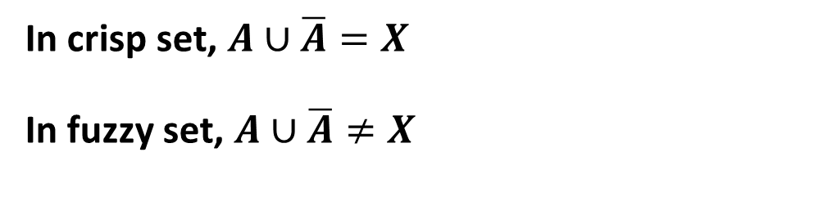
Properties of Fuzzy Set
Fuzzy sets follow the properties of crisp sets except the following two:
Law of excluded middle
In crisp set, $A∪\overline{A}=X$
In fuzzy set, $A∪\overline{A}≠X$

Slide 82
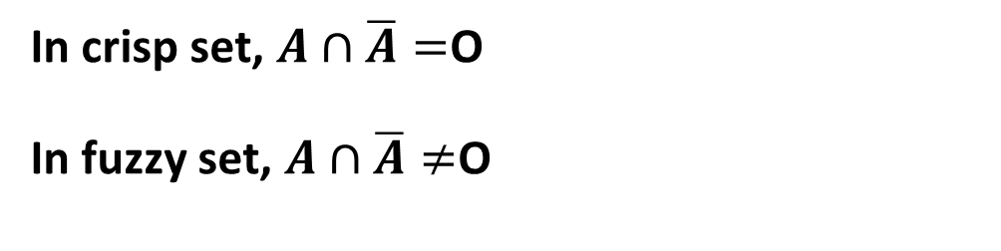
Law of contradiction
In crisp set, $A∩\overline{A}=$O
In fuzzy set, $A∩\overline{A}≠$O

Slide 83
Summary:
A few terms related to Fuzzy Sets have been defined
Some standard Operations in Fuzzy Sets have been explained
Properties of Fuzzy Sets have been explained

